Slide 1
Wireless Health Platform CASE STUDY (For Understanding PURPOSE)

Slide 2
study aims to propose a wireless sensor network platform based on ZigBee, an emerging wireless transmission technology, to avoid negligence in taking measurements, to provide more complete healthcare, and to improve the quality of medical care for the aged population
. Five objectives are covered in the healthcare platform:
Allow the elderly to perform the measurements through wireless transmission without being restricted to specific locations, reduce the need for wires, and send out alerts to the medical personnel.
Connect with the database through a system interface so as to query the previously measured data and display line graphs, with which the elderly could better understand the data and the family could directly see understand the past physical conditions of the elderly and interact with the elderly.

Slide 3
(3) Provide emergency alerts for the users to identify an exception physical conditions in time so that the elderly can receive the appropriate treatment.
(4) Store long-term measurement data in the database so as to inform the medical personnel about the past physical conditions; such measurement data could enhance the quality of diagnoses.
(5) Use a camera to transmit the user’s image to the computer-based system so that the family could remotely observe the current conditions of the user.

Slide 4
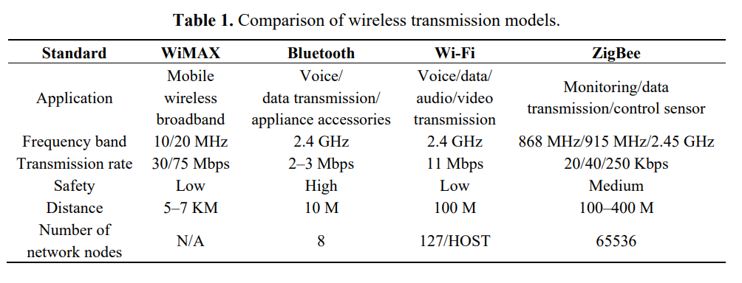

Slide 5
WiMAX. Also called the fourth-generation wireless communication (4G), it is used by mobile wireless broadband, which follows the IEEE 802.16 standards [17] and has a maximum transmission distance of 7–10 km and a maximum speed of 70 Mbps. It can replace fixed networks. It offers high transmission rates and broad communication coverage, but has not been very popular because of the high cost.
Bluetooth. Bluetooth, applys the IEEE 802.15.1 standards [18] and is a short-distance wireless transmission technology mainly applied to wireless communication between mobile phones and hands-free devices as well as computers and external wireless peripherals, such as mice, headphones, microphones, and printers.

Slide 6
(3)Wi-Fi. Wi-Fi, following the standards of IEEE 802.11 [19], has a transmission rate of about 11 Mbps, and is a high-speed wireless network protocol widely utilized in the past years for network connections, such as laptops, smart phones, and tablet PCs. However, the power consumption is comparatively high.
(4) ZigBee. ZigBee was originally set up for home networks. Its continuous development now allows broader applications, in addition to home networks. The specifications follow the IEEE 802.15.4 standards [20], with a transmission rate of about 250 Kbps. Since ZigBee offers low power consumption, low costs, long communication distance, and multiple nodes, its applications could be broadened with various sensors.

Slide 7
SALIENT features of ZigBee
Among the different wireless technologies, the ZigBee Wireless Transmission Module is often selected for healthcare systems that require frequent measurements and text-based data transmission that the low power-consumption. Besides, in consideration of the simplicity in operation and user acceptance, ZigBee can be easily installed, has lower costs, and supports various networks. When a node is out of order, other nodes could be selected as the path for signal transmission to ensure the continuous operation of the entire system

Slide 8
(1) Low cost. The simple protocol and small storage account for the low costs of ZigBee, so that it costs merely US $2 per chip. (2) Low power consumption. ZigBee uses sleep mode when not working, and the startup time is merely 15 ms, which is faster than Bluetooth which takes 8 s to add a node. ZigBee can rapidly recover and connect when nodes are required and go into sleep mode again after transmitting data. Such a transformation allows ZigBee to prolong battery life. Various types of batteries could support ZigBee service for periods ranging from six months up to two years.
(3) High reliability. With Collision Avoidance of talk-when-ready, a confirmation reply would be sent after receiving each control instruction or transmitted data envelope feature. Without such a reply, the transmission would proceed again to ensure the transmission of physiological information. ZigBee thus presents high-reliability information transmission.
(4) High expandability. ZigBee can cover up to 65,536 nodes in the network. Such network nodes would automatically construct a mesh network for rapidly allocating nodes. In other words, each ZigBee node could be connected with many nodes to show the larger capacity.

Slide 9
(5) Support for various network structures. ZigBee supports star, tree, and web structures, which have distinct advantages for different projects. A web structure could provide higher reliability so that other nodes could be used as a path for transmitting signals when one node is broken.
(6) Security. ZigBee offers three levels of security mode, including non-security setting, utilizing Access Control List (ACL) for preventing illegal data acquisition, and applying 128 bit Advanced Encryption Standard (AES) with complete data transmission checking function. Such measures ensure the security of ZigBee and prevent the data from being changed or accessed by attackers

Slide 10
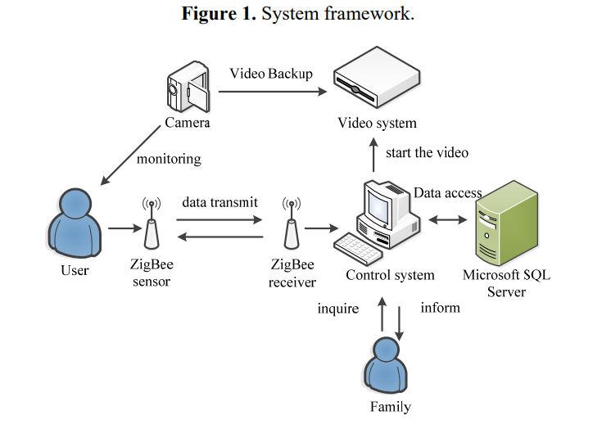

Slide 11
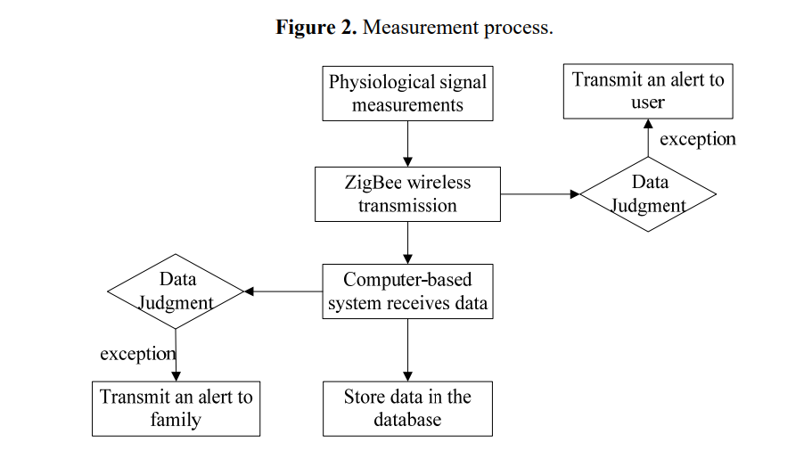

Slide 12
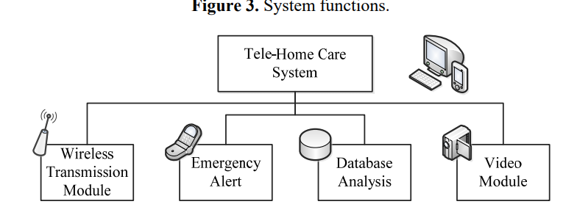

Slide 13
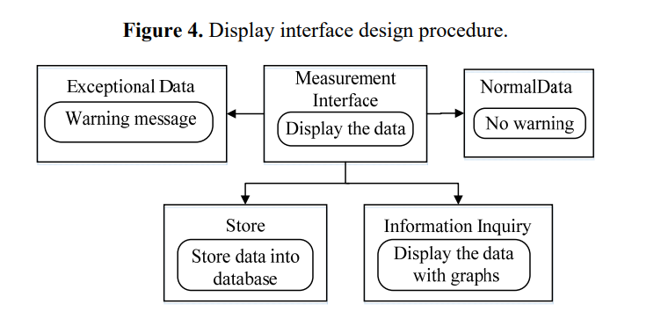

Slide 14
